Slide 1

Team Yellow
Super Mario Bro FC Level 1-1 & Boss fight

Slide 2
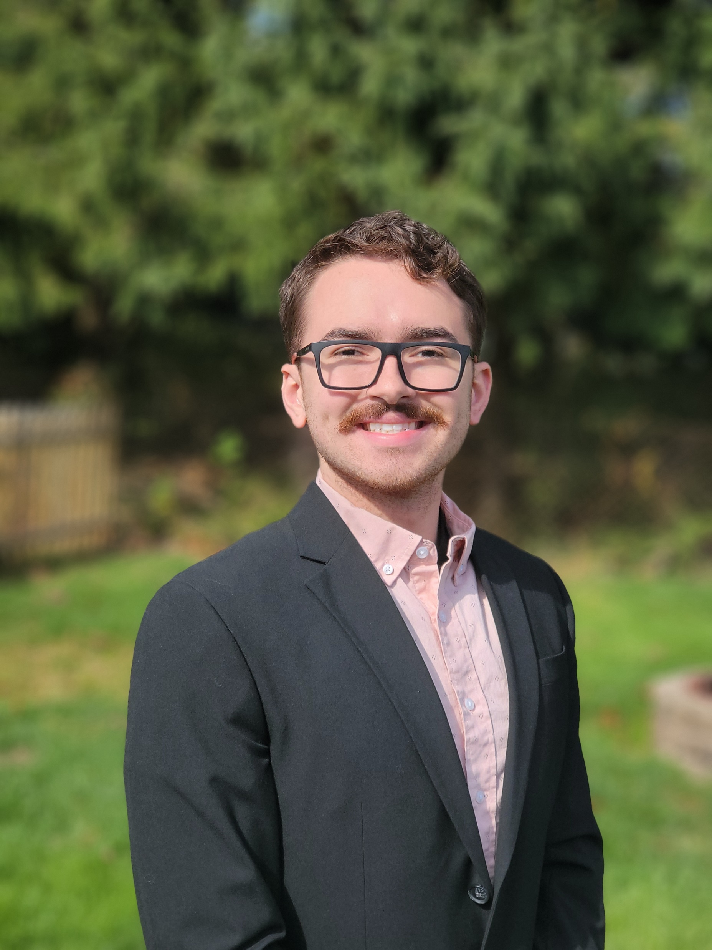
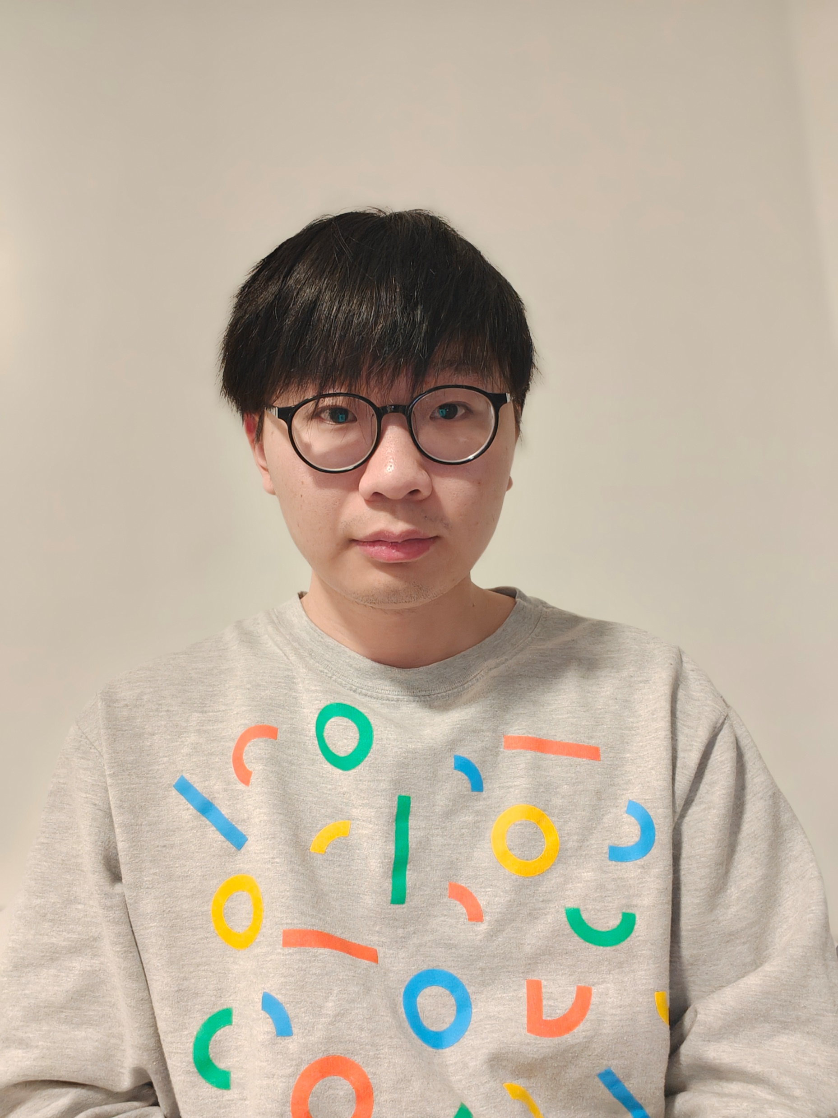

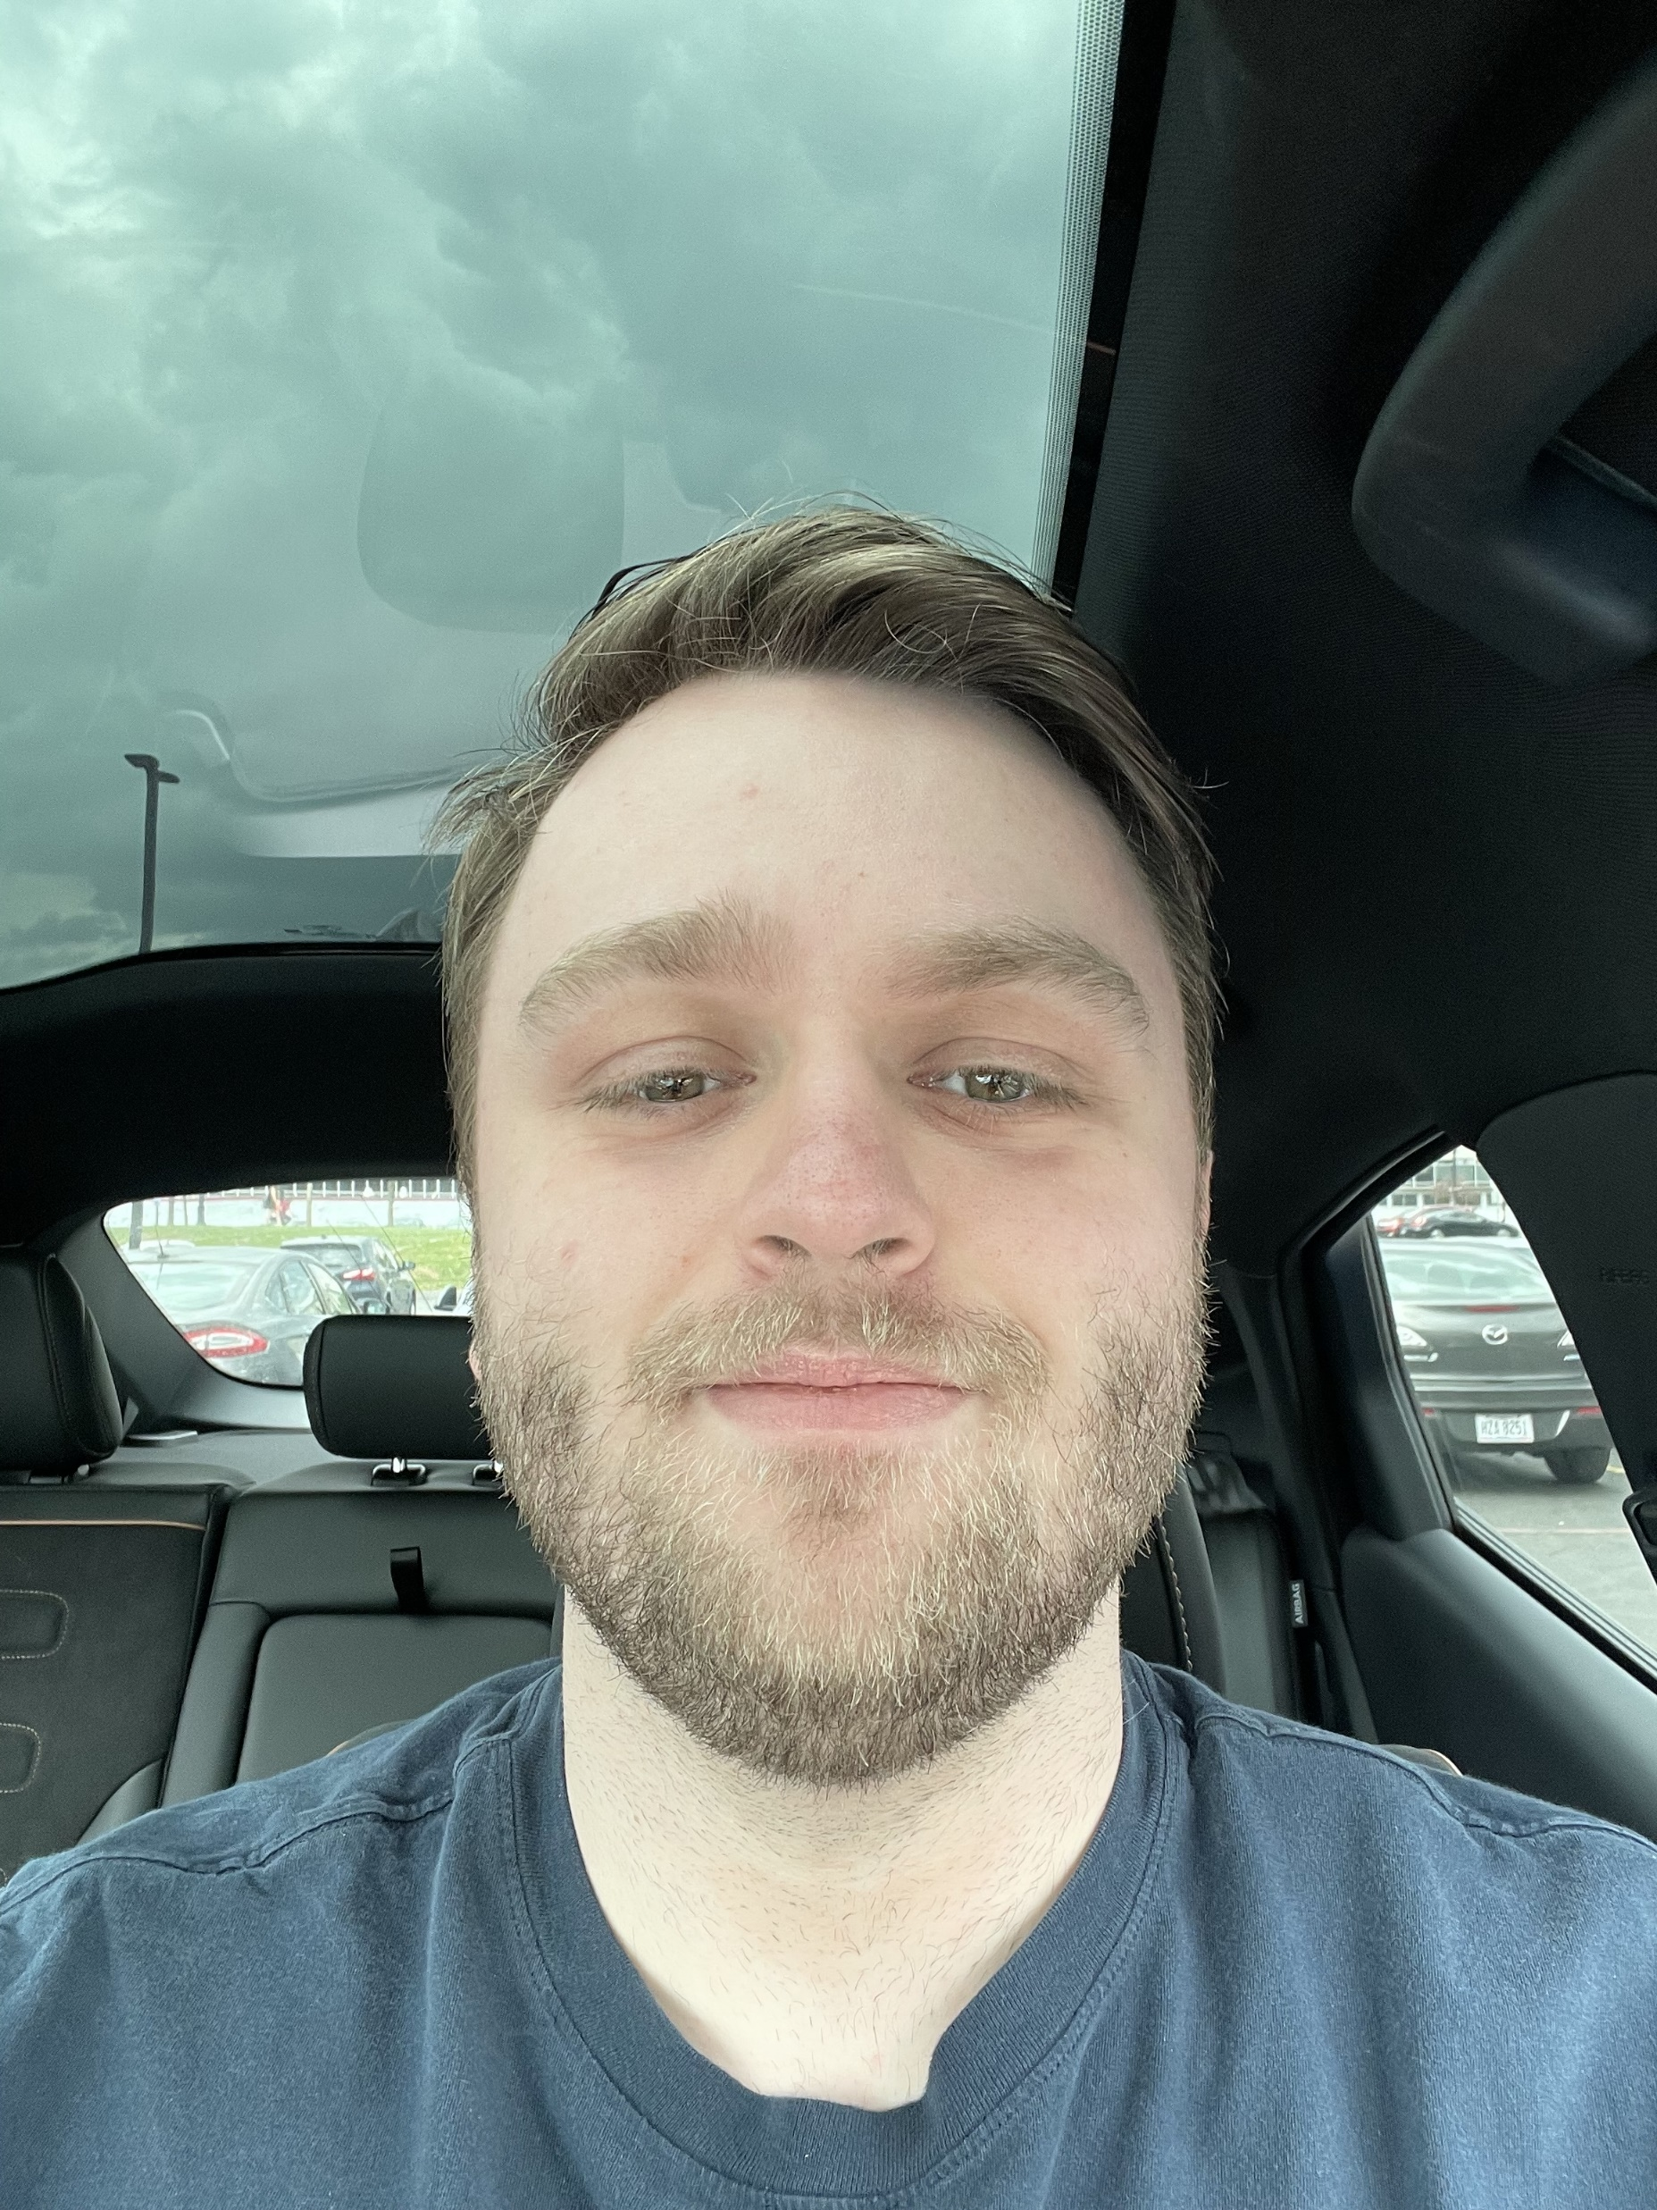
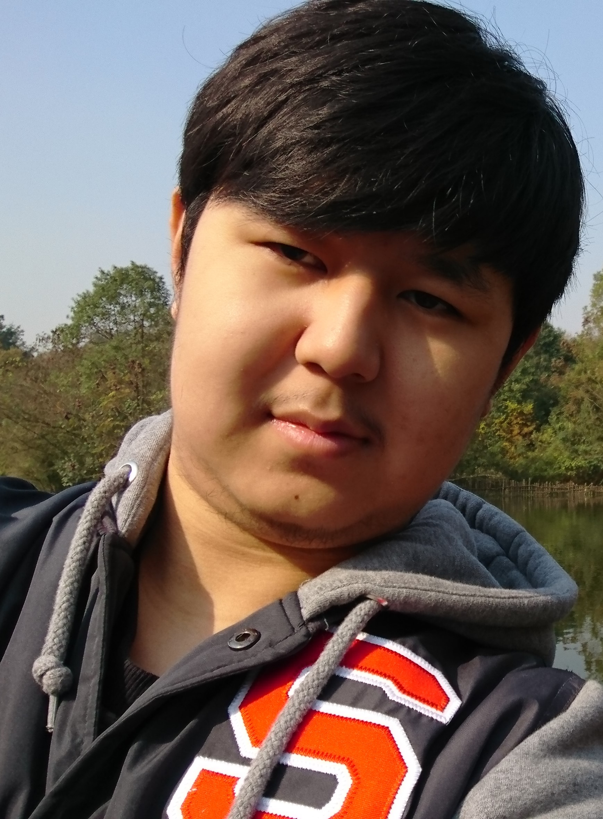
Team member
Kyle Kauffman
Yao Lu
Zhuozi Xie
Seth Welch
Adam Cote
Shuangchen Zhou

Slide 3

Sprint Features
Full experience of Super Mario Bros. Level 1-1
New Boss level Design
New Mario power-ups(Moon Jump, Super Fireball Ability)
Bowser AI
Bowser Angry Mode(Destroy floor)
HUD

